Slide 1
Issue of Web Technology

Slide 2
Web Application
A web application:
addresses a particular problem, even if it’s simply finding some information
is as interactive as a desktop application
has a Content Management System

Slide 3
Web application architecture
Web application architecture is a mechanism that determines how application components communicate with each other.
Notes:
Or, in other words, the way the client and the server are connected is established by web application architecture.

Slide 4
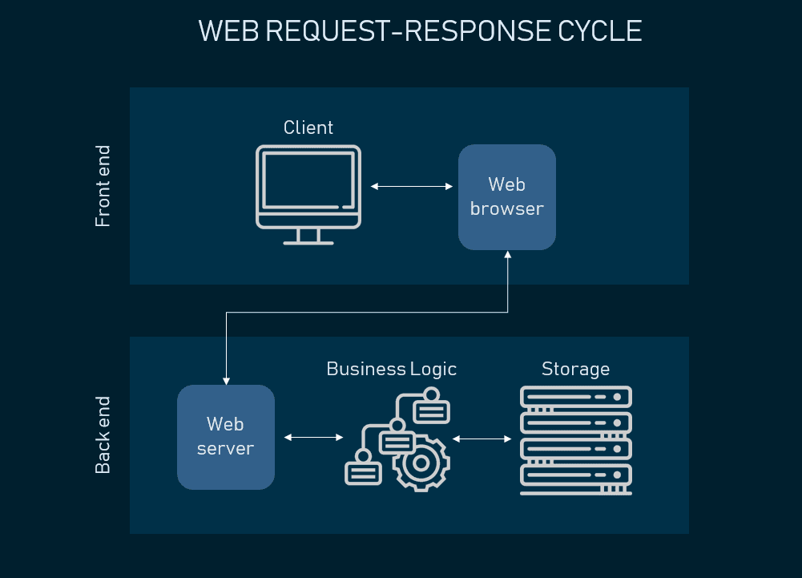
How the web request work

Slide 5
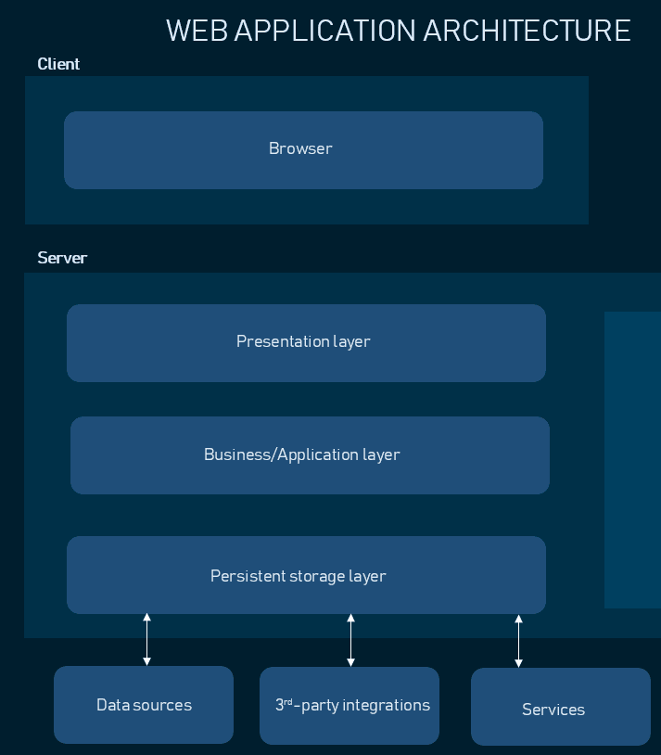
Web application architecture (3 tier architecture)

Slide 6
3 tier architecture
Most web applications are developed by separating its main functions into layers, or tiers.
This allows you to easily replace and upgrade each layer independently.
This architectural pattern is called Multi- or Three-Tier Architecture.

Slide 7
Presentation layer
accessible to users via a browser and consists of user interface components that support interaction with the system
Developed using 3 technologies
HTML
CSS
JavaScript

Slide 8
Business Layer/ Application layer
accepts user requests from the browser, processes them, and determines the routes through which the data will be accessed.
Notes:
For example, if your application is a hotel booking website, business logic will be responsible for the sequence of events a traveler will go through when booking a room.

Slide 9
Persistence layer/ Data Access Layer
Also called the storage or data access layer
Centralized location that provides access to the persistent storage of an application.
Closely connected to the business layer, so the logic knows which database to talk to and the data retrieving process is more optimized
Third-party integrations. Payment gateways, social logins etc.
Notes:
Payment gateways, social logins etc are all integrations connected to the application’s back end via pieces of code called APIs. They allow your software to source data from other software and widen your functionality without coding it from scratch.

Slide 10
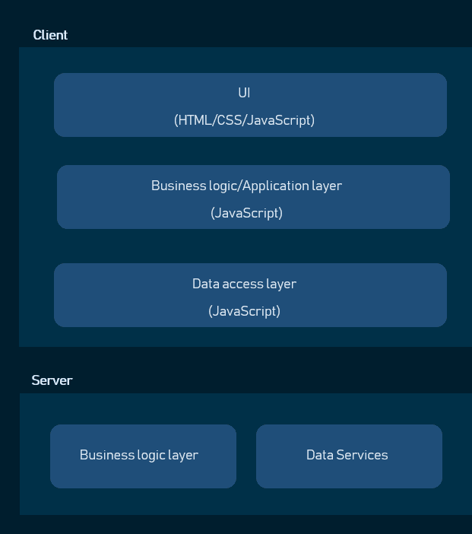
Single page application architecture

Slide 11
Single page application architecture
moved the application logic to the client-side and using server-side only as data storage
Website will run fast and ease the load of the server
Dependencies between components are tight. This means that making changes to one of the UI elements necessitates rewriting the whole front end code.
Since application logic is moved to client side hence they have to be written using client-side scripting e.g. javascript

Slide 12
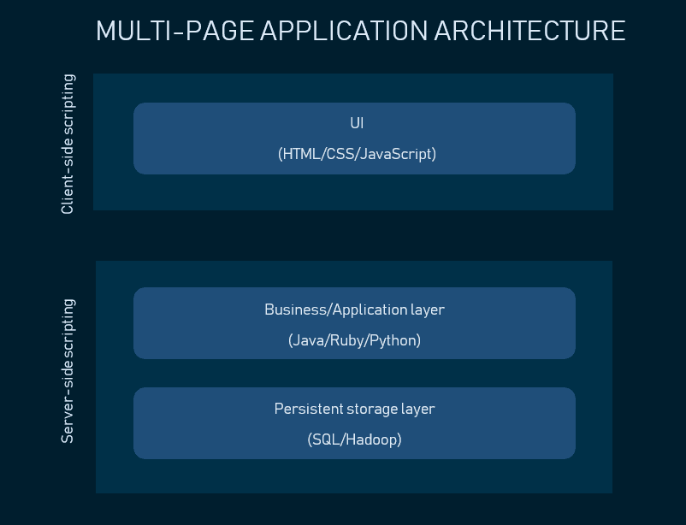

Slide 13
N-Tier Architecture
also called multi-tier architecture
software is engineered to have the processing, data management, and presentation functions physically and logically separated
Easier to manage because when you work on one section, the changes you make will not affect the other functions.
Notes:
“N” in the name n-tier architecture refers to any number from 1.
That means that these different functions are hosted on several machines or clusters, ensuring that services are provided without resources being shared and, as such, these services are delivered at top capacity.

Slide 14
N-tier architecture
N-tier architecture divides an application into three different tiers. These would be the
logic tier,
the presentation tier, and
the data tier.

Slide 15
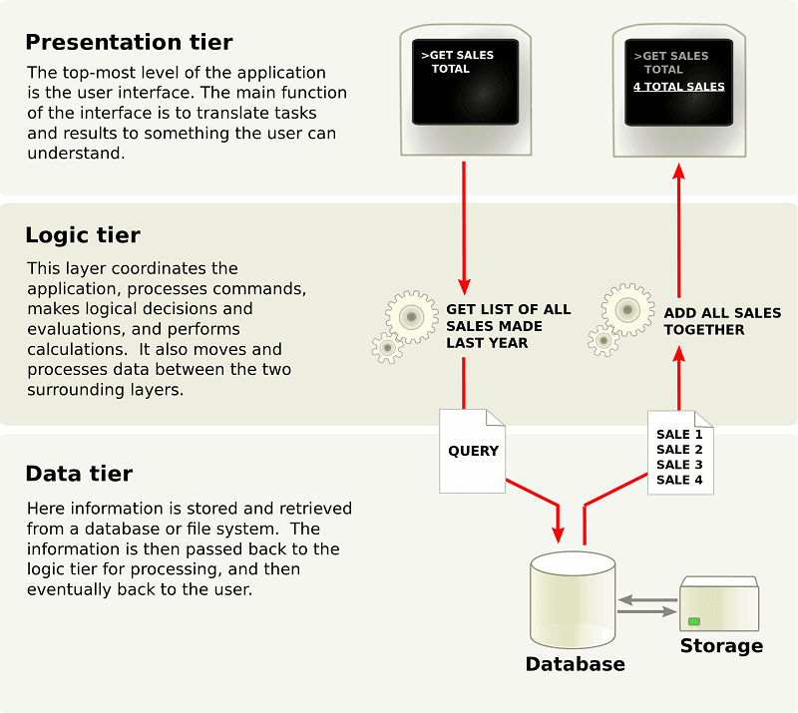

Slide 16
Benefits of N-Tier Architecture?
There are several benefits to using n-tier architecture for your software. These are scalability, ease of management, flexibility, and security.
Secure: You can secure each of the three tiers separately using different methods.
Easy to manage: You can manage each tier separately, adding or modifying each tier without affecting the other tiers.
Scalable: If you need to add more resources, you can do it per tier, without affecting the other tiers.
Flexible: Apart from isolated scalability, you can also expand each tier in any manner that your requirements dictate.

Slide 17
Benefits of N-Tier Architecture?
There are several benefits to using n-tier architecture for your software. These are scalability, ease of management, flexibility, and security.
Secure: You can secure each of the three tiers separately using different methods.
Easy to manage: You can manage each tier separately, adding or modifying each tier without affecting the other tiers.
Scalable: If you need to add more resources, you can do it per tier, without affecting the other tiers.
Flexible: Apart from isolated scalability, you can also expand each tier in any manner that your requirements dictate.

